Slide 1



ICCAD-2017 CAD Contest for Multi-Deck Standard Cell Legalization: Problem Description, Benchmarks, and Results
Nima Karimpour Darav
Ismail Bustany
Andrew Kennings
Notes:
v

Slide 2
Outline
Problem Description & Challenges
Multi-Deck Cell Legalization Problem Constraints
Evaluation Metrics
Benchmark Design Suites
Contest Results
Team Videos
The Winners

Slide 3
Problem Description & Challenges
Notes:
So what are the main challenges in legalization?

Slide 4
A Sample of Multi-Deck Cells
vss pin
vdd pin
We used 1-4 deck high cells in the contest.
In advanced technology node real designs, it is common to common to see 2, 3, 4, 8, 16, 32-deck highcells.
1-deck 2-deck 3-deck 4-deck

Slide 5
Motivation: Why use multi-deck cells?
Multi-deck cells (e.g. multi-bit registers (MBR’s)) are becoming more prevalent in advanced technology nodes (1-10% of cells) since they can improve PPA:
Lower Power: Fewer number of clock sinks seen by the clock-tree synthesis tool means less overall capacitance driven by the clock net.
Improve Performance: Shared logic (in clock gating or set-reset logic) and internally timing optimized MBR’s from a library team.
Lower clock skew in sequential gates: clock paths in MBR’s are internally balanced.
Smaller Area Utilization: Total number of clock buffers needed can be reduced.
https://www.embedded.com/design/mcus-processors-and-socs/4433619/2/Using-multi-bit-flip-flop-custom-cells-to-achieve-better-SoC-design-efficiency

Slide 6
Traditional Single-Deck Legalization Requirements
Remove cell overlaps.
Minimally perturb incoming placed netlist to preserve (or improve) WL, routing, and timing quality metrics.
Satisfy complex design rules.
Fast and robust to handle large number of cells in state-of-the-art designs.

Slide 7
Multi-Deck Standard Cell Legalization Requirements
Remove cell overlaps.
Minimally perturb incoming placed netlist to preserve (or improve) WL, routing, and timing quality metrics.
Satisfy complex design rules.
Fast and robust to handle large number of cells in state-of-the-art designs.
Plus,
Mixed-size cell legalization problem.

Slide 8
Multi-Deck Standard Cell Legalization Problem
C
1
C3
C
1
C
3
C8
C2
C6
C8
C
2
C
6
C
5
C
2
C
6
C
5
C7
C7
C4
C4
Blocked area
A mixed-size legalization problem.
More challenging to model than the standard single-deck cell legalization problem.
Akin to an NP-hard multi-commodity network flow/Assignment problem.
Movable cells
Notes:
Legalization is a step to mainly remove overlaps between cells and align cells with rows while considering additional constraints.

Slide 9
Standard Cell Legalization Challenges
Legalization
Routability
Wire Length
Timing closure
Robust
Runtime
Complex Design Rules
Notes:
With shrinking the size of transistors, complicated rules and multi-deck cells have become prevalent, The legalization process should address these two issues as well.

Slide 10
Multi-Deck Standard Cell Legalization Challenges
Legalization
Routability
Wire Length
Timing closure
Robust
Runtime
Complex
Design Rules
Mixed sized Cells
Notes:
With shrinking the size of transistors, complicated rules and multi-deck cells have become prevalent, The legalization process should address these two issues as well.

Slide 11
Contest Legalization Problem Constraints
Notes:
So what are the main challenges in legalization?

Slide 12
Hard Constraints for the contest
P/G alignment
Row and site alignment.
Fence regions.
30 minute timeout.
Maximum 8 threads per run.

Slide 13
P/G Alignment

Slide 14
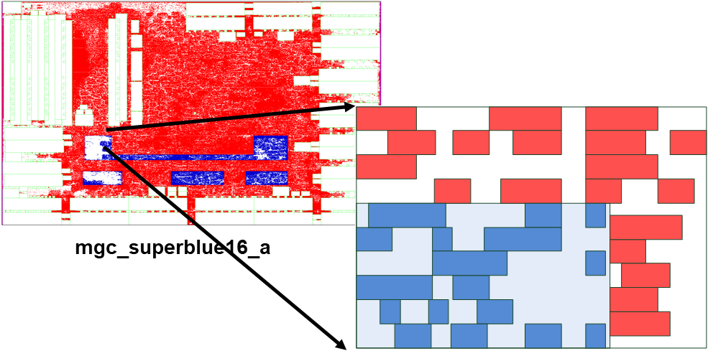
Fence Region Constraints

Slide 15
Soft Constraints for the Contest
Target Area Utilization
Maximum cell movement objective
Detailed routing constraints
- Cell spacing, pin access and shorts.

Slide 16
Challenges – Edge Spacing Constraints
Prone to pin access and short problems
Two cells are too close to each other
Notes:
Edge spacing rules are a minimum space between two or more objects. In this example, the shown two cells are too close to each other, therefore, the pins in pink are prone to pin access or short problems

Slide 17
Evaluation Metrics
Notes:
So what are the main challenges in legalization?

Slide 18
Evaluation Metrics
The score of a solution is computed based on 5 metrics:
Maximum cell movement - penalized by the maximum movement specific for the design.
Average cell movement
HPWL - penalized by the maximum utilization defined for the design.
Runtime
Detailed routing rule violations

Slide 19

Total Design Score
$$S_{total}=S_{am}∗S_{mm}∗\left(1+S_{hpwl}+S_{v}\right)∗(1+S_{t})$$
Where
$$S_{mm} :Maximum movement score$$
$$S_{am} :Average movement score$$
$$S_{hpwl} :HPWL score$$
$$S_{t} :Runtime score$$
$$S_{v} :Soft detailed routing rules constraint score$$

Slide 20
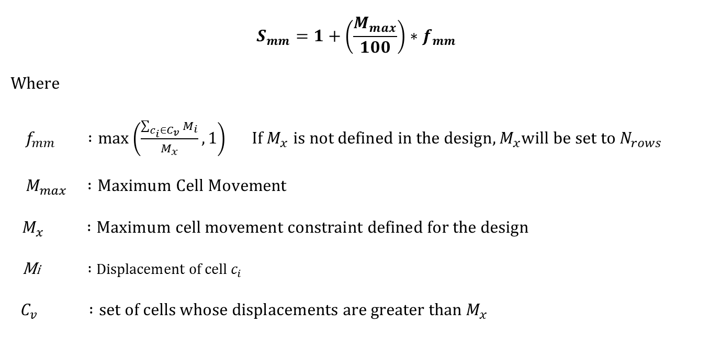
Maximum Cell Movement Score
$$S_{mm}=1+\left(\frac{M_{max}}{100}\right)∗f_{mm}$$
Where
$f_{mm} :\max\left(\frac{\sum_{c_{i}∈C_{v}}{M_{i}}}{M_{x}}, 1\right) If M_{x} is not defined in the design, M_{x}will be set to N_{rows}$
$${ M}_{max} :Maximum Cell Movement$$
$${ M}_{x} :Maximum cell movement constraint defined for the design$$
Mi$:Displacement of cell c_{i}$
$C_{v} :set of cells whose displacements are greater than M_{x}$

Slide 21

Average Movement Score
$$S_{am}=\frac{\sum_{k=1}^{4}{M_{ avg, k}}}{4}$$
Where
$$M_{avg,k} :Average Cell Movement of all cells with a height equal to k rows$$

Slide 22
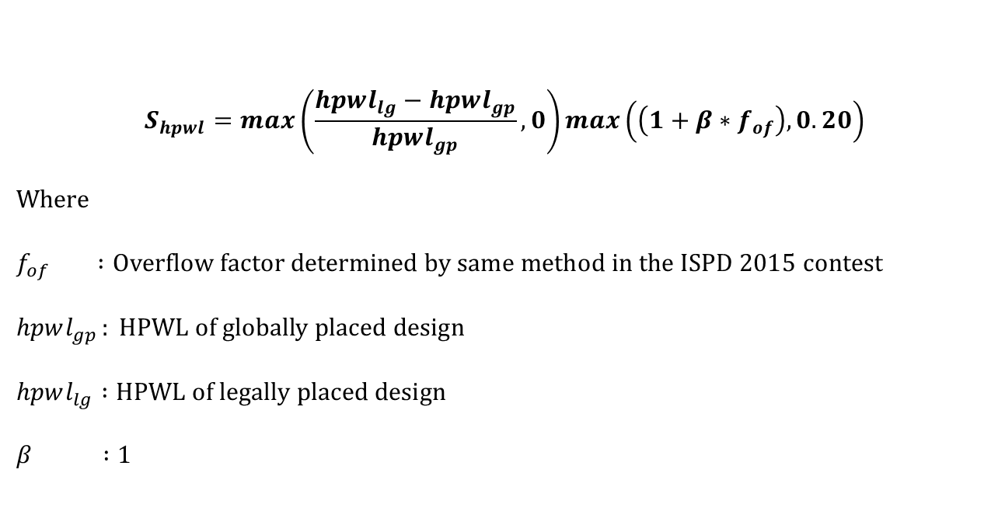
HPWL Score
$$S_{hpwl}=max\left(\frac{hpwl_{lg}−hpwl_{gp}}{hpwl_{gp}}, 0\right)\max\left(\left(1+β∗f_{of}\right), 0.20\right)$$
Where
$$f_{of} :Overflow factor determined by same method in the ISPD 2015 contest$$
$$hpwl_{gp }: HPWL of globally placed design$$
$$hpwl_{lg} :HPWL of legally placed design$$
$$β :1$$

Slide 23

Runtime Score
$$S_{t}=\max\left(−0.2,\min\left(0.2, 0.05∗\log_{2}\left(\frac{t_{team}}{t_{median}}\right)\right)\right)$$
Where
$t_{team} :design runtime$ for given team
$$t_{median}:Median design runtime of all teams$$

Slide 24

Soft Detailed Routing Score
$$S_{v}=min(0.2,\frac{N_{v}}{N_{cells}})$$
Where
$$N_{cells} :Number of cells in the design$$
$$N_{v} :Number of soft constraint violations in the solution$$

Slide 25
Benchmark Design Suites
Notes:
So what are the main challenges in legalization?

Slide 26
Benchmark Format
cells.lef includes the physical characteristics of the technology library for the standard cell library, macros, and IO cells, etc.
tech.lef provides the physical characteristics of the routing layers, Vertical Interconnect Accesses (VIAs), placement site types, etc.
design.def includes design-specific logical and physical such as net-list connectivity, grouping information, physical constraints, cell locations and orientations, routing geometry data, P/G mesh, etc.
placement.constraints is a text file including some other constraints such as maximum target utilization or the maximum displacement. Any constraint defined in this file is considered a soft constraint.

Slide 27
Benchmark Design Suites
The designs were created from the ISPD 2014 and 2015 Placement Contest benchmarks.
The global placements were generated by Eh?Placer.
Two sets of benchmarks were used for the final evaluation results:
- Released design suite includes 8 designs provided for the participants.
- Hidden design suite includes 8 designs used for blind evaluation.
- Both suites were equally weighted for the final evaluation
If a team could not generate a legal placement in a specified time (30 mins), the respective score is set to 1+e6.

Slide 28
Released Benchmark Suite
Design | #Rows | #Macros | #Cells | #Nets | #Fence Regions | #I/O | % cell types |  |  |  | utilization
 |  |  |  |  |  |  | 1xH | 2xH | 3xH | 4xH
des_perf_b_md1 | 300 | 0 | 112679 | 122951 | 12 | 374 | 94.8 | 5.2 | 0 | 0 | 54.98
des_perf_b_md2 | 300 | 0 | 112679 | 122951 | 12 | 374 | 90.47 | 6.02 | 2.01 | 1.5 | 64.69
edit_dist_1_md1 | 361 | 0 | 130661 | 133223 | 0 | 2574 | 90.31 | 6.12 | 2.04 | 1.53 | 67.47
edit_dist_a_md2 | 400 | 6 | 127414 | 134051 | 1 | 2574 | 90.31 | 6.12 | 2.04 | 1.53 | 59.42
fft_2_md2 | 171 | 0 | 32281 | 33307 | 0 | 3010 | 89.62 | 6.56 | 2.18 | 1.64 | 83.12
fft_a_md2 | 400 | 6 | 30625 | 32090 | 0 | 3010 | 89.57 | 6.59 | 2.19 | 1.65 | 32.41
fft_a_md3 | 400 | 6 | 30625 | 32090 | 0 | 3010 | 93.42 | 2.19 | 2.19 | 2.19 | 31.24
pci_bridge32_a_md1 | 200 | 4 | 29533 | 34058 | 3 | 361 | 90.39 | 6.07 | 2.02 | 1.52 | 49.57

Slide 29
Hidden Benchmark Suite
Design | #Rows | #Macros | #Cells | #Nets | #Fence Regions | #I/O | % cell types |  |  |  | utilization
 |  |  |  |  |  |  | 1xH | 2xH | 3xH | 4xH
des_perf_1 | 222 | 0 | 112644 | 112880 | 0 | 374 | 100.00 | 0.00 | 0.00 | 0.00 | 90.64
des_perf_a_md1 | 450 | 4 | 103589 | 115187 | 4 | 374 | 95.66 | 4.34 | 0.00 | 0.00 | 55.11
des_perf_a_md2 | 450 | 4 | 103589 | 115187 | 4 | 374 | 96.99 | 1.00 | 1.00 | 1.00 | 55.92
edit_dist_a_md3 | 400 | 6 | 119626 | 134051 | 1 | 2574 | 93.88 | 2.04 | 2.04 | 2.04 | 57.22
pci_bridge32_a_md2 | 200 | 4 | 29533 | 34058 | 3 | 361 | 85.51 | 7.08 | 4.04 | 3.37 | 57.72
pci_bridge32_b_md1 | 400 | 6 | 26134 | 32546 | 3 | 361 | 90.38 | 6.07 | 2.02 | 1.52 | 28.68
pci_bridge32_b_md2 | 400 | 6 | 26134 | 32546 | 3 | 362 | 97.97 | 1.01 | 1.01 | 1.01 | 19.72
pci_bridge32_b_md3 | 400 | 6 | 26134 | 32546 | 3 | 363 | 94.94 | 1.01 | 2.02 | 2.02 | 23.98

Slide 30
Contest Results
Notes:
So what are the main challenges in legalization?

Slide 31
Teams
11 final submissions from Brazil, China, Germany, Hong Kong, Taiwan, and the USA.
8 out of 11 teams could generate at least one legal solution.
The ranking was significantly impacted by the number of legal solutions generated by the teams.
Notes:
In summary, our proposed algorithm results in less maximum and average cell movement. In addition, the proposed method is scalable and robust with respect to the floorplan complexity and number of cells in designs.

Slide 32
Released Suite Scores
cada005, cada012, cada040, cada041, and cada053 generated legal solutions for all designs of the released suite within the 30-min allotted time.
Team | Score | #Failures
cada001 | 100018.68 | 1
cada005 | 10.50 | 0
cada006 | 800000.00 | 8
cada012 | 4.86 | 0
cada021 | 800000.00 | 8
cada036 | 800000.00 | 8
cada040 | 9.22 | 0
cada041 | 7.64 | 0
cada045 | 100008.20 | 1
cada053 | 6.75 | 0
cada099 | 800000.00 | 8

Slide 33
Hidden Suite Scores
Only two teams generated legal solutions for all designs in the suite within the allotted 30-min time
Team | Score | #Failures
TBA | 6913.44 | 0
TBA | 201640.75 | 2
TBA | 800000.00 | 8
TBA | 117.34 | 0
TBA | 800000.00 | 8
TBA | 800000.00 | 8
TBA | 512841.70 | 4
TBA | 100762.61 | 1
TBA | 700001.07 | 7
TBA | 600001.75 | 6
TBA | 718655.40 | 7

Slide 34
And Now, Introducing the Top 6 Winning Teams!

Slide 35
The Winners!
Notes:
So what are the main challenges in legalization?

Slide 36
Released Benchmark Scores (runtime adjusted)
Team | des_perf_b_md1 |  |  | des_perf_b_md2 |  |  | edit_dist_1_md1 |  |  | edit_dist_a_md2
 | Raw Score | Runtime | Scaled Score | Raw Score | Runtime | Scaled Score | Raw Score | Runtime | Scaled Score | Raw Score | Runtime | Scaled Score
cada001 | 100000.00 | -- | 100000.00 | 0.88 | 4.80 | 0.82 | 11.55 | 5.14 | 10.71 | 4.42 | 4.79 | 4.07
cada005 | 1.32 | 9.34 | 1.31 | 1.52 | 23.23 | 1.59 | 1.23 | 25.00 | 1.28 | 1.22 | 27.07 | 1.27
cada012 | 0.63 | 6.59 | 0.61 | 0.72 | 6.26 | 0.68 | 0.73 | 8.58 | 0.70 | 0.53 | 7.59 | 0.50
cada040 | 1.05 | 34.28 | 1.13 | 0.97 | 56.47 | 1.07 | 1.58 | 67.10 | 1.76 | 0.74 | 108.00 | 0.84
cada041 | 1.27 | 10.85 | 1.27 | 0.92 | 18.01 | 0.94 | 0.82 | 20.60 | 0.84 | 0.78 | 31.50 | 0.83
cada045 | 100000.00 | -- | 100000.00 | 0.75 | 3.93 | 0.69 | 0.78 | 4.14 | 0.71 | 4.35 | 4.46 | 3.98
cada053 | 0.97 | 12.08 | 0.98 | 0.91 | 12.65 | 0.91 | 0.86 | 14.14 | 0.86 | 0.62 | 14.36 | 0.62
cada099 | 100000.00 | -- | 100000.00 | 100000.00 | -- | 100000.00 | 100000.00 | -- | 100000.00 | 100000.00 | -- | 100000.00
Team | fft_2_md2 |  |  | fft_a_md2 |  |  | fft_a_md3 |  |  | pci_bridge32_a_md1
 | Raw Score | Runtime | Scaled Score | Raw Score | Runtime | Scaled Score | Raw Score | Runtime | Scaled Score | Raw Score | Runtime | Scaled Score
cada001 | 1.06 | 1.08 | 0.95 | 0.63 | 1.13 | 0.58 | 0.50 | 1.11 | 0.47 | 1.14 | 1.24 | 1.08
cada005 | 2.01 | 6.34 | 2.06 | 0.70 | 4.03 | 0.71 | 0.56 | 3.30 | 0.57 | 1.64 | 4.51 | 1.71
cada012 | 0.79 | 1.60 | 0.74 | 0.53 | 1.41 | 0.50 | 0.42 | 1.36 | 0.39 | 0.76 | 1.43 | 0.73
cada040 | 1.81 | 27.42 | 2.05 | 0.61 | 5.07 | 0.64 | 0.47 | 4.53 | 0.49 | 1.15 | 7.40 | 1.24
cada041 | 1.47 | 30.64 | 1.68 | 0.53 | 2.50 | 0.52 | 0.41 | 2.45 | 0.41 | 1.15 | 2.51 | 1.15
cada045 | 1.01 | 0.93 | 0.90 | 0.56 | 11.53 | 0.62 | 0.43 | 10.39 | 0.47 | 0.90 | 0.94 | 0.84
cada053 | 1.21 | 4.35 | 1.21 | 0.63 | 3.16 | 0.63 | 0.49 | 2.95 | 0.49 | 1.05 | 2.75 | 1.05
cada099 | 100000.00 | -- | 100000.00 | 100000.00 | -- | 100000.00 | 100000.00 | -- | 100000.00 | 100000.00 | -- | 100000.00

Slide 37
Hidden Benchmark Scores (runtime adjusted)
Rank | TEAM | des_perf_b_md1 |  |  | des_perf_b_md2 |  |  | edit_dist_1_md1 |  |  | edit_dist_a_md2
 |  | Raw Score | Runtime (sec) | Score with runtime | Raw Score | Runtime (sec) | Score with runtime | Raw Score | Runtime (sec) | Score with runtime | Raw Score | Runtime (sec) | Score with runtime
1 | cada053 | 0.93 | 14.84 | 0.93 | 0.87 | 15.39 | 0.87 | 0.80 | 17.42 | 0.80 | 0.64 | 21.02 | 0.64
2 | cada012 | 0.79 | 8.27 | 0.75 | 0.85 | 9.35 | 0.82 | 1.66 | 11.93 | 1.61 | 0.69 | 12.10 | 0.66
3 | cada005 | 2.36 | 52.83 | 2.57 | 3.97 | 35.62 | 4.21 | 4.92 | 38.19 | 5.20 | 1.99 | 39.84 | 2.09
- | cada040 | Not legal | -- | -- | Not legal | -- | -- | Not legal | -- | -- | Not legal | -- | --
- | cada001 | Not legal | -- | -- | Not legal | -- | -- | Not legal | -- | -- | Not legal | -- | --
- | cada099 | Not legal | -- | -- | Not legal | -- | -- | Not legal | -- | -- | Not legal | -- | --
fft_2_md2 |  |  | fft_a_md2 |  |  | fft_a_md3 |  |  | pci_bridge32_a_md1 |  |  | Total Scores
Raw Score | Runtime (sec) | Score with runtime | Raw Score | Runtime (sec) | Score with runtime | Raw Score | Runtime (sec) | Score with runtime | Raw Score | Runtime (sec) | Score with runtime | Raw Score | with Runtime
0.95 | 4.02 | 0.95 | 0.58 | 6.42 | 0.58 | 0.45 | 6.35 | 0.45 | 1.00 | 3.90 | 1.00 | 6.22 | 6.22
1.24 | 2.47 | 1.19 | 0.57 | 1.83 | 0.51 | 0.44 | 1.79 | 0.40 | 1.01 | 1.58 | 0.94 | 7.23 | 6.89
2.98 | 7.21 | 3.10 | 1.99 | 8.49 | 2.04 | 3.03 | 8.50 | 3.10 | 3.30 | 8.38 | 3.48 | 24.55 | 25.79
Not legal | -- | -- | Not legal | -- | -- | Not legal | -- | -- | Not legal | -- | -- | -- | --
Not legal | -- | -- | Not legal | -- | -- | Not legal | -- | -- | Not legal | -- | -- | -- | --
Not legal | -- | -- | Not legal | -- | -- | Not legal | -- | -- | Not legal | -- | -- | -- | --
Rank | TEAM | des_perf_b_md1
1 | cada053
2 | cada012
3 | cada005
- | cada040
- | cada001
- | cada099

Slide 38
Impact of Hidden Benchmark on Final Scores
Only two teams, cada001 and cada012, could generate legal solutions for all 8 designs within the allotted time (30 min).
The runtime for some legalizers was significantly affected by the maximum movement constraints. This was especially deleterious for teams cada040 and cada053’s final scores.
Team cada012 performed best on these benchmarks.
Team | Score | #Failures
cada001 | 6913.44 | 0
cada005 | 201640.75 | 2
cada006 | 800000.00 | 8
cada012 | 117.34 | 0
cada021 | 800000.00 | 8
cada036 | 800000.00 | 8
cada040 | 512841.70 | 4
cada041 | 100762.61 | 1
cada045 | 700001.07 | 7
cada053 | 600001.75 | 6
cada099 | 718655.40 | 7

Slide 39
Top 6 Teams
1st place: 122.20
2nd place: 100770.25
3rd place: 106932.12
4th place: 201651.26
5th place: 512850.92
6th place: 600008.51
39

Slide 40
Honorable Mention ☺
Team cada053: RippleLG
The Chinese University of Hong Kong
Hong Kong
Haocheng Li, Wing-Kai Chow, Gengjie Chen,
Prof. Evangeline F. Y. Young, Prof. Bei Yu

Slide 41
Honorable Mention ☺
Team cada040: TU Dresden
Dresden University of Technology
Germany
Tilman Horst, Andreas Krinke, Steve Bigalke, Robert Fischbach,
Arthur Nothdurft, Sergii Osmolovskyi, Mohamed Sabra, Matthias Thiele,
Prof. Jens Lienig

Slide 42
Honorable Mention ☺
Team cada005: NCKU_95416
National Cheng Kung University
Taiwan
Tai-Ting Chen, You-Lun Deng, Yi-Wen Wang, Prof. Jai-Ming Lin

Slide 43
3rd Place ☺
Team cada001: Ophidian
Federal University of Santa Catarina
Brazil
Renan Netto, Tiago Augusto Fontana, Sheiny Fabre,
Thiago Barbato, Chrystian Guth,
Prof. Jose Luis Guntzel, Prof. Laercio Lima Pilla

Slide 44
2nd Place ☺
Team cada041: ColdNoodle
National Taiwan University
Taiwan
Shih-Wei Hsieh, Shao-Chun Hung
Prof. Yao-Wen Chang

Slide 45
1st Place ☺
Team cada012: C_TI
Fuzhou University
China
Ziran Zhu, Yuhang Chen, Ye Huang, Xingquan Li,
Prof. Jianli Chen, Prof. Wenxing Zhu, Prof. Genghua Fan

Slide 46
Released Benchmark Scores (runtime adjusted)
Team | des_perf_b_md1 |  |  | des_perf_b_md2 |  |  | edit_dist_1_md1 |  |  | edit_dist_a_md2
 | Raw Score | Runtime | Scaled Score | Raw Score | Runtime | Scaled Score | Raw Score | Runtime | Scaled Score | Raw Score | Runtime | Scaled Score
cada001 | 100000.00 | -- | 100000.00 | 0.88 | 4.80 | 0.82 | 11.55 | 5.14 | 10.71 | 4.42 | 4.79 | 4.07
cada005 | 1.32 | 9.34 | 1.31 | 1.52 | 23.23 | 1.59 | 1.23 | 25.00 | 1.28 | 1.22 | 27.07 | 1.27
cada012 | 0.63 | 6.59 | 0.61 | 0.72 | 6.26 | 0.68 | 0.73 | 8.58 | 0.70 | 0.53 | 7.59 | 0.50
cada040 | 1.05 | 34.28 | 1.13 | 0.97 | 56.47 | 1.07 | 1.58 | 67.10 | 1.76 | 0.74 | 108.00 | 0.84
cada041 | 1.27 | 10.85 | 1.27 | 0.92 | 18.01 | 0.94 | 0.82 | 20.60 | 0.84 | 0.78 | 31.50 | 0.83
cada045 | 100000.00 | -- | 100000.00 | 0.75 | 3.93 | 0.69 | 0.78 | 4.14 | 0.71 | 4.35 | 4.46 | 3.98
cada053 | 0.97 | 12.08 | 0.98 | 0.91 | 12.65 | 0.91 | 0.86 | 14.14 | 0.86 | 0.62 | 14.36 | 0.62
cada099 | 100000.00 | -- | 100000.00 | 100000.00 | -- | 100000.00 | 100000.00 | -- | 100000.00 | 100000.00 | -- | 100000.00
Team | fft_2_md2 |  |  | fft_a_md2 |  |  | fft_a_md3 |  |  | pci_bridge32_a_md1
 | Raw Score | Runtime | Scaled Score | Raw Score | Runtime | Scaled Score | Raw Score | Runtime | Scaled Score | Raw Score | Runtime | Scaled Score
cada001 | 1.06 | 1.08 | 0.95 | 0.63 | 1.13 | 0.58 | 0.50 | 1.11 | 0.47 | 1.14 | 1.24 | 1.08
cada005 | 2.01 | 6.34 | 2.06 | 0.70 | 4.03 | 0.71 | 0.56 | 3.30 | 0.57 | 1.64 | 4.51 | 1.71
cada012 | 0.79 | 1.60 | 0.74 | 0.53 | 1.41 | 0.50 | 0.42 | 1.36 | 0.39 | 0.76 | 1.43 | 0.73
cada040 | 1.81 | 27.42 | 2.05 | 0.61 | 5.07 | 0.64 | 0.47 | 4.53 | 0.49 | 1.15 | 7.40 | 1.24
cada041 | 1.47 | 30.64 | 1.68 | 0.53 | 2.50 | 0.52 | 0.41 | 2.45 | 0.41 | 1.15 | 2.51 | 1.15
cada045 | 1.01 | 0.93 | 0.90 | 0.56 | 11.53 | 0.62 | 0.43 | 10.39 | 0.47 | 0.90 | 0.94 | 0.84
cada053 | 1.21 | 4.35 | 1.21 | 0.63 | 3.16 | 0.63 | 0.49 | 2.95 | 0.49 | 1.05 | 2.75 | 1.05
cada099 | 100000.00 | -- | 100000.00 | 100000.00 | -- | 100000.00 | 100000.00 | -- | 100000.00 | 100000.00 | -- | 100000.00

Slide 47
Hidden Benchmark Scores (runtime adjusted)
Rank | TEAM | des_perf_b_md1 |  |  | des_perf_b_md2 |  |  | edit_dist_1_md1 |  |  | edit_dist_a_md2
 |  | Raw Score | Runtime (sec) | Score with runtime | Raw Score | Runtime (sec) | Score with runtime | Raw Score | Runtime (sec) | Score with runtime | Raw Score | Runtime (sec) | Score with runtime
1 | cada053 | 0.93 | 14.84 | 0.93 | 0.87 | 15.39 | 0.87 | 0.80 | 17.42 | 0.80 | 0.64 | 21.02 | 0.64
2 | cada012 | 0.79 | 8.27 | 0.75 | 0.85 | 9.35 | 0.82 | 1.66 | 11.93 | 1.61 | 0.69 | 12.10 | 0.66
3 | cada005 | 2.36 | 52.83 | 2.57 | 3.97 | 35.62 | 4.21 | 4.92 | 38.19 | 5.20 | 1.99 | 39.84 | 2.09
- | cada040 | Not legal | -- | -- | Not legal | -- | -- | Not legal | -- | -- | Not legal | -- | --
- | cada001 | Not legal | -- | -- | Not legal | -- | -- | Not legal | -- | -- | Not legal | -- | --
- | cada099 | Not legal | -- | -- | Not legal | -- | -- | Not legal | -- | -- | Not legal | -- | --
fft_2_md2 |  |  | fft_a_md2 |  |  | fft_a_md3 |  |  | pci_bridge32_a_md1 |  |  | Total Scores
Raw Score | Runtime (sec) | Score with runtime | Raw Score | Runtime (sec) | Score with runtime | Raw Score | Runtime (sec) | Score with runtime | Raw Score | Runtime (sec) | Score with runtime | Raw Score | with Runtime
0.95 | 4.02 | 0.95 | 0.58 | 6.42 | 0.58 | 0.45 | 6.35 | 0.45 | 1.00 | 3.90 | 1.00 | 6.22 | 6.22
1.24 | 2.47 | 1.19 | 0.57 | 1.83 | 0.51 | 0.44 | 1.79 | 0.40 | 1.01 | 1.58 | 0.94 | 7.23 | 6.89
2.98 | 7.21 | 3.10 | 1.99 | 8.49 | 2.04 | 3.03 | 8.50 | 3.10 | 3.30 | 8.38 | 3.48 | 24.55 | 25.79
Not legal | -- | -- | Not legal | -- | -- | Not legal | -- | -- | Not legal | -- | -- | -- | --
Not legal | -- | -- | Not legal | -- | -- | Not legal | -- | -- | Not legal | -- | -- | -- | --
Not legal | -- | -- | Not legal | -- | -- | Not legal | -- | -- | Not legal | -- | -- | -- | --
Rank | TEAM | des_perf_b_md1
1 | cada053
2 | cada012
3 | cada005
- | cada040
- | cada001
- | cada099

Slide 48
ICCAD-2017 CAD Contest for Multi-Deck Standard Cell Legalization: Problem Description, Benchmarks, and Results
Nima Karimpour Darav
Ismail Bustany
Andrew Kennings
Notes:
v

